Slide 1
Hostel Room Security Automation Using Raspberry Pi 3

Slide 2
INTRODUCTION
The world is changing. There is a need for a faster and accurate user identification and authentication method. Face recognition has become one of the most important user identification methods.

Slide 3
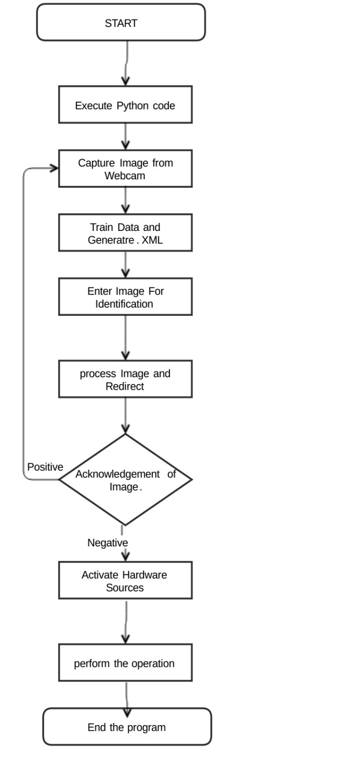
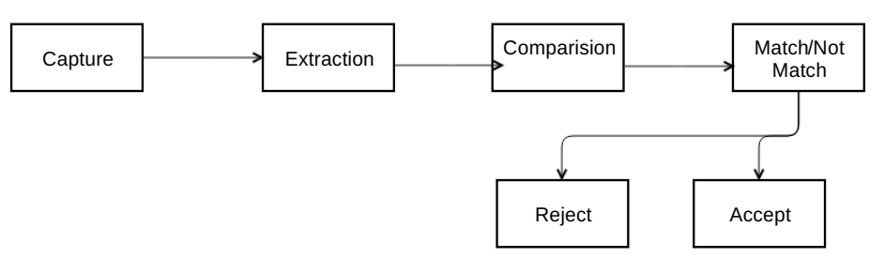
Data Flow

Slide 4
FACE DETECTION USING HAAR CASCADES
Object Detection using Haar feature-based cascade classifiers is an effective method
It is an adaptive machine learning based approach in which a cascade function is trained from several positive and negative images.
This algorithm requires plenty of positive images (images of faces) and negative images (images without faces) to train the classifier. Then Features are extracted from it.
Every feature is a single value obtained by subtracting sum of pixels under white rectangle from sum of pixels under black rectangle.
All possible sizes and locations of every kernel are used to calculate plenty of features. To calculate each feature, the sum of pixels under white and black rectangles is found.

Slide 5
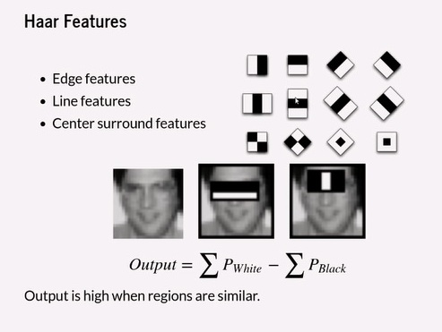

Slide 6
Face Recognition
Face Detection: Look at the picture and find a face in it.
Data Gathering: Extract unique characteristics of Ram’s face that it can use to differentiate him from another person, like eyes, mouth, nose, etc.
Data Comparison: Despite variations in light or expression, it will compare those unique features to all the features of all the people you know.
Face Recognition: It will determine “Hey, that’s my boy Ram”

Slide 7
The LBPH Face Recognizer Process
The idea with LBPH is not to look at the image as a whole, but instead, try to find its local structure by comparing each pixel to the neighboring pixels.
Take a 3×3 window and move it across one image. At each move (each local part of the picture), compare the pixel at the center, with its surrounding pixels. Denote the neighbors with intensity value less than or equal to the center pixel by 1 and the rest by 0.
After you read these 0/1 values under the 3×3 window in a clockwise order, we will have a binary pattern like 11100011 that is local to a particular area of the picture. When we finish doing this on the whole image, we will have a list of local binary patterns.

Slide 8
Now, after we get a list of local binary patterns, we convert each one into a decimal number using binary to decimal conversion and then we make a histogram of all of those decimal values
In the end, we will have one histogram for each face in the training data set. That means that if there were 100 images in the training data set then LBPH will extract 100 histograms after training and store them for later recognition. Remember, the algorithm also keeps track of which histogram belongs to which person.
Later during recognition, the process is as follows:
Feed a new image to the recognizer for face recognition.
The recognizer generates a histogram for that new picture.
It then compares that histogram with the histograms it already has.
Finally, it finds the best match and returns the person label associated with that best match.

Slide 9
E-Mail and Buzzer
At last after getting the acknowledgement , if it is a false image, activate the hardware sources.
Send Email. Add the image as an attachment which was lastly used for image recognition. Also add the tolerance ratio in the body section.
Activate buzzer. A musical note is defined to play sound via the passive buzzer module.

Slide 10
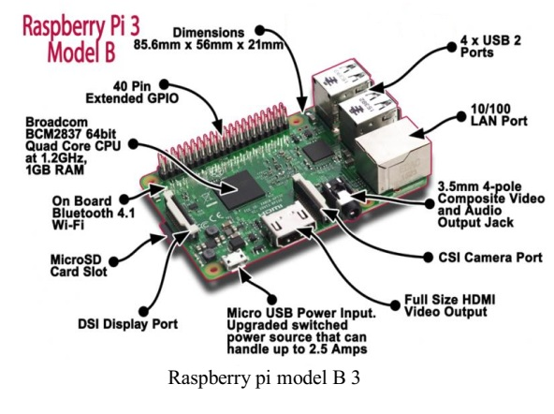
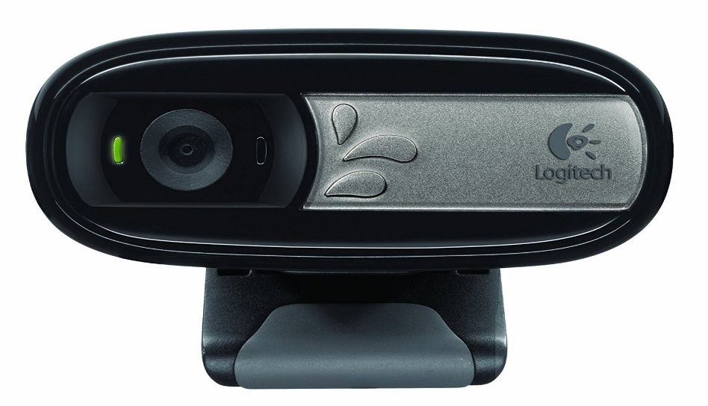
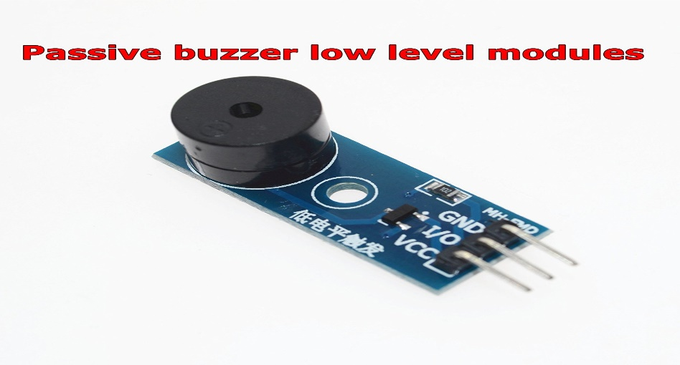
Hardware Used

Slide 11
Error and Preventation
Compiling Opencv in raspberry pi is still a big task. It takes long time and patience
Proxy error.
Python version Error.
Use Mobile data or broadband for any job. University Wi-Fi Sucks.. Many ports are blocked.
Use Opencv latest version (Now 3.3.0)
Don’t use recent version of raspberry pi OS. They have lot of bugs, which need to be fixed. (Now I am using raspbien Jessie instead of raspbien stretch)
Handle hardware with care and provide proper power supply.

Slide 12
FUTURE SCOPE:
It will yield more accurate results with the use of Iris algorithms and more enhanced Camera Module.
Better optimization of algorithm with the help of advance Machine Learning.
Use of better hardware to perform image training with different angles and emotions.
2-Way authentication implementation:
Idea is to recognize the face and generate a code and Send it to the recognized Subject. The subject have to Input the code to complete the protocol.

Slide 13
REFERENCES
https://docs.opencv.org/master/d7/d9f/tutorial_linux_install.html
https://projects.raspberrypi.org/en/projects/parent-detector
https://diyhacking.com/raspberry-pi-gpio-control/
https://www.sunfounder.com/learn/sensor-kit-v2-0-for-raspberry-pi-b-plus/lesson-10-buzzer-module-sensor-kit-v2-0-for-b-plus.html
http://www.instructables.com/id/ShareCreate-Edit-Files-Between-Your-Mac-and-Raspbe/
Special Thanks to:
https://stackoverflow.com/
https://github.com/

Slide 14
Thank you

